Slide 1
E-Portfolio SEO & Starting a business
Glenda Eaton
Owner, Glenda Eaton Web Design LLC

Slide 2
Overview
E-Portfolio
Why it is important
What information should you include
Tips for making creation easy
Hosting
Graphic designers/free web site creators and their rules
Who.is database and how to select your domain name
Buying your domain name
Hosting plans - what to look for and get the best deal for your money

Slide 3
Overview
Helping yourself
Homework files
Create free web sites for friends and/or family
Online Tutorials
Take extra classes not in degree program - continue education
Learn to integrate multiple programs for a project
Library
Internship
Know who you are and choose the right opportunity for you!

Slide 4
Overview
Search Engine Optimization - SEO
What is it and why is it so important?
Keywords
Social Media
PR Ratings
Backlinks
Alt tags
Search Engines
Tips for free SEO

Slide 5
Overview
Starting a business in Illinois
FEIN
Secretary of State
City License
Selling products? (Illinois Dept of Revenue)
Start investing now
Bank Account
Marketing yourself
Contracts
Create your business web site (can use your e-portfolio domain/hosting)
Include your e-portfolio
Come up with a pricing plan

Slide 6
Overview
Starting a business in Illinois (cont.)
Reputations and perceptions by clients
Common questions asked by potential clients
Graphics? (etsy.com)
Find your niche
Create a survey for clients
Red flags to look for in a client
Conclusion

Slide 7
E-Portfolio
Why is it so important?
Homework
Employers
Internship
Business Clients
What information should you include?
Positive Aspects of yourself
Class list – completed, in progress, future
Any web sites you have completed
Homework & Extras – Organized
Your degree program and projected graduation date

Slide 8
E-portfolio cont.
Keep ALL homework files
****Ask your instructors if they grant permission for displaying homework and tests****
Helping yourself
On-line tutorial web sites
http://psd.tutsplus.com/ (Photoshop)
http://vector.tutsplus.com/ (Illustrator)
http://www.w3schools.com/js/ (JavaScript)
http://webdesign.about.com/od/htmlxhtmltutorials/ (HTML)
http://www.smashingmagazine.com/2008/01/17/adobe-flash-tutorials-best-of/ (Flash)
Use Search engines to find more
Library – Search multi-county database
Take extra classes
Complete Portfolio projects at end of each chapter for yourself

Slide 9
E-portfolio cont.
Tips for making your e-portfolio unique
Use tables
Put all menus in tables – easier to move around and control
Play with CSS
Look at other web sites to get design ideas
Use free widgets to create cool effects
Use other software programs to boost your design
Pay attention to file sizes and download times

Slide 10
Hosting
Free web site creators and their rules
Great for graphic designers
Wix.com, weebly.com
Rules, ads
Who.is database – best practice on how to select your domain name (make it relevant (example: firstnamelastnamewebdesign.com))
Buying your domain name
Hosting Plans – what to look for and get the best deal
http://www.consumer-rankings.com
Don’t necessarily choose the #1 in a list. Do your homework.
Not all hosting companies are equal
SEO, blog, ftp capabilities, email account, data usage

Slide 11
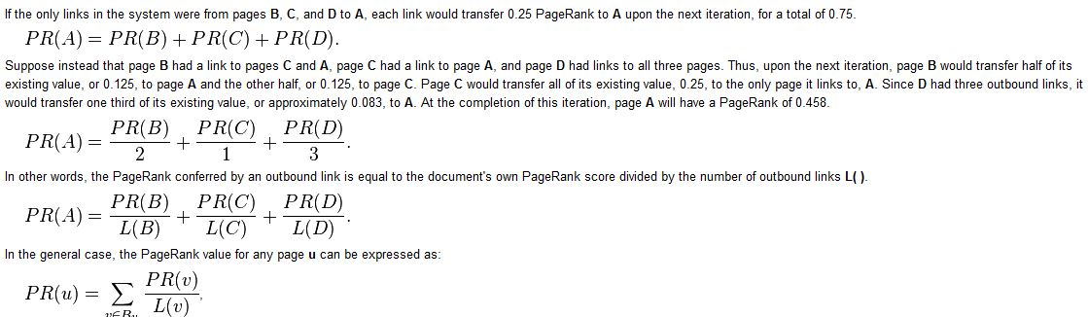
Search Engine Optimization
What is SEO?
http://en.wikipedia.org/wiki/PageRank

Slide 12
Search Engine Optimization cont.
Search engine optimization (SEO) is the process of affecting the visibility of a website or a web page in a search engine's "natural" or un-paid ("organic") search results. In general, the earlier (or higher ranked on the search results page), and more frequently a site appears in the search results list, the more visitors it will receive from the search engine's users. SEO may target different kinds of search, including image search, local search, video search, academic search, news search and industry-specific vertical search engines.

Slide 13
Search Engine Optimization cont.
Keywords – must be specific to the web site’s content
Alt tags and Titles
Each page title has to be unique – come up with a naming system
Without doing this, points will be deducted from a search engine standpoint
No empty tags
Validate code via the W3 validator
http://validator.w3.org/nu/

Slide 14
Search Engine Optimization cont.
PR Ratings
Search engines have a web site ranking system
PR 10 being the highest and PR 0 being the lowest
Link to high PR web sites but it is not always easy!
Wikipedia (PR 10)
Educational web sites (.edu)
Google, WordPress
Search for ‘High Ranking PR web sites’
Changes frequently

Slide 15
Search Engine Optimization cont.
PR Ratings
Backlinks
A backlink is any link received by a web node (web page, directory, website, or top level domain) from another web node.
Inbound links were originally important (prior to the emergence of search engines) as a primary means of web navigation; today, their significance lies in search engine optimization (SEO). The number of backlinks is one indication of the popularity or importance of that website or page (for example, this is used by Google to determine the Page Rank of a webpage). Outside of SEO, the backlinks of a webpage may be of significant personal, cultural or semantic interest: they indicate who is paying attention to that page.
There are both Free and Expensive Backlinks out on the internet. BE CAREFUL! 90% are bogus!

Slide 16
Search Engine Optimization cont.
PR Ratings
What makes low PR ratings:
HTML Validation Errors
Duplicate or Missing Alt tags
Duplicate or Missing Titles
CSS Validation Errors
Last modified
Broken Links (both internal and external)
Too long of a Title tag >65 chars
Conflicting Character encoding
And more…..

Slide 17
Search Engine Optimization cont.
Tips for Free SEO
Google
Create a Google gmail account
https://accounts.google.com/Login
Google +
Create an account for yourself and for all clients
You can manage all of your clients Google + accounts and SEO from your own
http://www.google.com/webmasters/ by clicking the red ‘add a site’ button
You can request Google to crawl the web site
Create a Sitemap for yourself and every web site you create.
Sitemaps are a way to tell Google about pages on your site we might not otherwise discover. In its simplest terms, a XML Sitemap—usually called Sitemap, with a capital S—is a list of the pages on your website. Creating and submitting a Sitemap helps make sure that Google knows about all the pages on your site, including URLs that may not be discoverable by Google's normal crawling process.

Slide 18
Search Engine Optimization cont.
Tips for Free SEO
Google + cont.
Fetch your web site
Google will generate a .html file for you. Do not modify. Ftp the file to top level directory of your web site (i.e. same directory as your index.html)
Even if you don’t own or manage the web site, ask Google to crawl a URL: https://www.google.com/webmasters/tools/submit-url/
Indexing web sites: https://support.google.com/webmasters/answer/2642366?hl=en&ref_topic=2371374

Slide 19
Search Engine Optimization cont.
Tips for Free SEO
Social Media
Most common: Twitter, Facebook, Pinterest, Instagram, Blogs (these fluctuate so keep up with trends)
Not so common but are trendy: Yelp!, Manta, YP, Angie’s List, Associations
Twitter currently has a PR 10 ranking

Slide 20
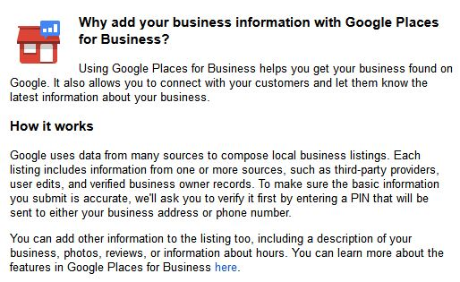
Search Engine Optimization cont.
Tips for Free SEO
Google Places
http://www.google.com/business/placesforbusiness/

Slide 21
Search Engine Optimization cont.
Tips for Free SEO
Google Places cont.
Google needs to verify that your business is legitimate; therefore you will be required to request a Security PIN be sent via the United States Postal Service to the business’s postal address. This process may take up to 2 weeks. Once received, you will need to follow the instructions within the document and enter the 5 digit PIN. Until this is completed, Google will show your business as incomplete.

Slide 22
Search Engine Optimization cont.
Tips for Free SEO
Videos
Youtube – connect these videos within your web site
SEO Software
Top #10 SEO Software Programs
http://seo-software-review.toptenreviews.com/
SEO Suite by http://www.link-assistant.com/buy.html
Rank Tracker, WebSite Auditor, SEO SpyGlass, LinkAssistant
Pro: can verify backlinks Con: $$$

Slide 23
Starting a Business
First Steps
Obtain necessary licenses
Federal Employer Identification Number (FEIN)
FREE, Online Application, receive number within minutes
http://www.irs.gov/Businesses/Small-Businesses-%26-Self-Employed/Apply-for-an-Employer-Identification-Number-%28EIN%29-Online
Secretary of State (Illinois)
http://www.cyberdriveillinois.com/departments/business_services/corp.html
Must look up business name to verify no duplication
http://www.ilsos.gov/corporatellc/

Slide 24
Starting a Business cont.
Secretary of State (Illinois) $612.75
File for a LLC – Limited Liability Status (Form LLC-1.15)
http://www.cyberdriveillinois.com/publications/pdf_publications/llc115.pdf
Request a Certificate of Good Standing $47
http://www.cyberdriveillinois.com/departments/business_services/corp.html
Selling Products? (unsure of cost)
Illinois Dept. of Revenue
http://www.revenue.state.il.us/Businesses/register.htm
(217) 785-3707

Slide 25
Starting a Business cont.
Start Investing NOW!
Create a business banking account
Market yourself
Word of mouth, Facebook, Twitter, Business Cards (gas stations, business bulletin boards, etc)
Contracts
http://webdesignlaw.com/contracts/forms-introduction
http://www.smashingmagazine.com/2013/04/03/legal-guide-contract-samples-for-designers/

Slide 26
Starting a Business cont.
Create your business web site (can use your e-portfolio domain/hosting)
Domain should be relevant!
Include your e-portfolio
Come up with a pricing plan
By the hour, Overall price, etc.
Reputations and perception by clients
You will find that most clients are hesitant when it comes to web design companies. Unfortunately, there are lots of people out there that take advantage of people and more so in our profession. Be aware of this and assure clients on how you are different.

Slide 27
Starting a Business cont.
Keep ALL receipts!
You can claim your out-of-pocket education expenses on your taxes as long as it is relevant to your business. This includes your books.
Claim - camera, computers, printers, desks, etc. up to one year prior to starting your business.
Come up with a budget
Use Excel, Intuit QuickBooks, etc. for keeping up with your expenses and profits.

Slide 28
Starting a Business cont.
Common questions asked by clients
Be prepared to answer the following:
What do you charge?
How fast can you complete my project?
Do you have any references?
What type of services do you offer?
What will you need from me?
Not creative? That’s ok!
Cheap digital graphics – etsy.com

Slide 29
Starting a Business cont.
Not Creative? Cont.
http://www.smashingmagazine.com/2010/11/09/50-free-high-quality-icons-sets/
http://www.designbolts.com/2012/11/26/25-free-simple-black-seamless-patterns-for-website-backgrounds/
Searching for free xyz clip art may return better results
Find your niche
Create a survey for clients
Benefits – Information collection, design contemplation, communication set-up
For a sample survey – see my web site glendaeatonwebdesign.com click on survey button towards bottom of home page

Slide 30
Starting a Business cont.
Red Flags to look for in clients
Some clients will tell you they leave all design and creative abilities to you…..THIS IS NEVER TRUE! What this means: I don’t know where to start. You will need to guide them with all design aspects.
“I don’t want to learn!” – I will teach a client web design terms. This helps with communication and it also helps them be part of the process. Those who don’t care, they will be the ones that come back and suggest you took their money!
“I don’t have time for filling out the survey.” – They are not invested in helping you complete their project. This amounts to many hours of running around in circles.

Slide 31
Starting a Business cont.
Red Flags to look for in clients cont.
“I will give you X amount of dollars. You can do everything for that amount.” - BE CAREFUL if they don’t clarify! They are not specifying what ‘everything’ is in their mind. This will come back to haunt you.
Client has skipped from web hosting company to web hosting company multiple times in a short period of time. - They are looking for ‘something’ and you must find out what ‘it’ is. Also, when launching their web site, you may find technical problems. (example: internal company email, A records)

Slide 32
Conclusion
INVEST IN YOURSELF! You are worth it!!!

